Slide 1
INTRODUCTION TO PYTHON

Slide 2
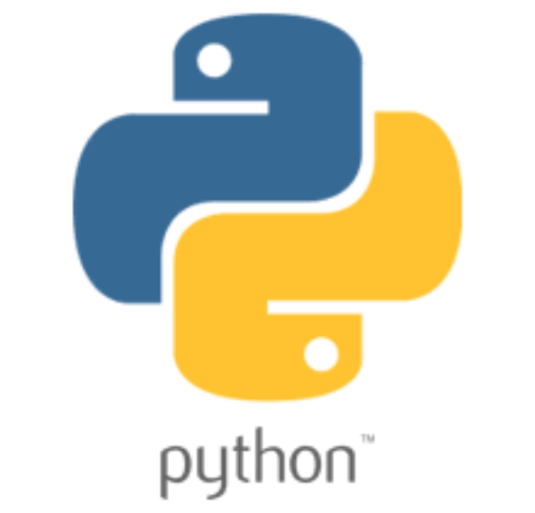
WHAT IS PYTHON
Python is an interpreted, object-oriented, high-level programming language.
It is both a programming language and a scripting language.
Python is developed under an OSI-approved open source license, making it freely usable and distributable, even for commercial use.

Slide 3
HISTORY OF PYTHON
Python was developed in the late 1980s.
Developed by Guido van Rossum at Centrum Wiskunde & Informatica (CWI) in the Netherlands as a successor to the ABC language,
Python 2.0 was released on October 16, 2000, with many major new features, including a cycle-detecting garbage collector for memory management.
Python 3.0, a major, backwards-incompatible release, was released on December 3, 2008 after a long period of testing and is currently the most popular IDLE version of python.

Slide 4
WHY IS PYTHON POPULAR?
Easy to Learn and Use
Python language is incredibly easy to use and learn for new beginners and newcomers. The python language is one of the most accessible programming languages available because it has simplified syntax and not complicated, which gives more emphasis on natural language. Due to its ease of learning and usage, python codes can be easily written and executed much faster than other programming languages.
Mature and Supportive Python Community
Python was created more than 30 years ago, which is a lot of time for any community of programming language to grow and mature adequately to support developers ranging from beginner to expert levels. There are plenty of documentation, guides and Video Tutorials for Python language are available that learner and developer of any skill level or ages can use and receive the support required to enhance their knowledge in python programming language.

Slide 5
WHY IS PYTHON POPULAR?
Hundreds of Python Libraries and Frameworks
Python has excellent libraries that you can use to select and save your time and effort on the initial cycle of development. There are also lots of cloud media services that offer cross-platform support through library-like tools, which can be extremely beneficial. For example : matplotlib for plotting charts and graphs, SciPy for engineering applications, science, and mathematics etc.
Versatility, Efficiency, Reliability, and Speed
One best thing about versatility of python language is that it can be used in many varieties of environments such as mobile applications, desktop applications, web development, hardware programming, and many more. The versatility of python makes it more attractive to use due to its high number of applications. Python can be used in nearly any kind of environment, and one will not face any kind of performance loss issue irrespective of the platform one is working. It is also much faster, reliable and efficient as it is independent of the developing environment and hence is almost always consistent.

Slide 6
Python Tutorial
Installation

Slide 7
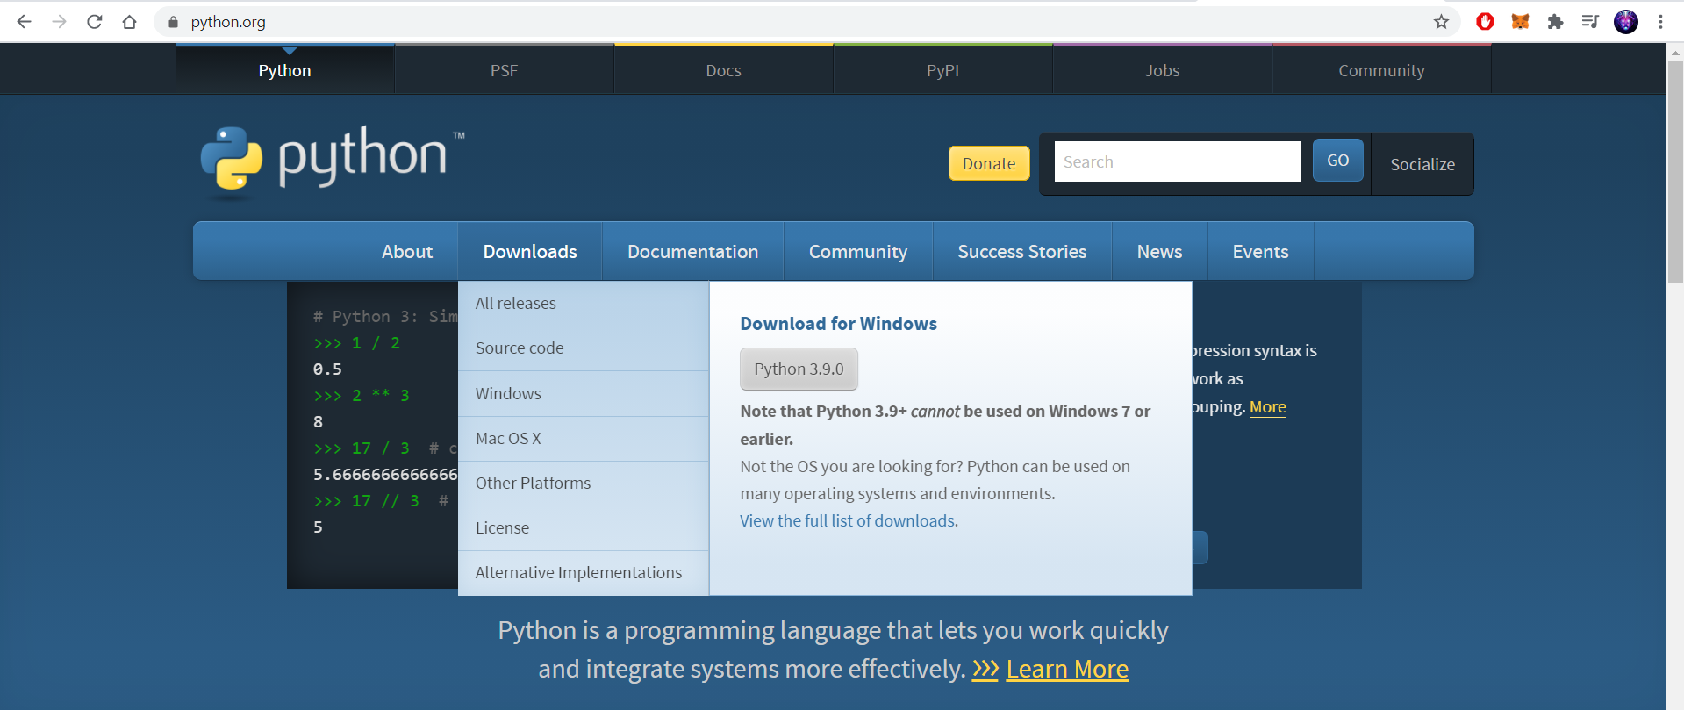
STEP 1
Go to python.org and click on downloads. Mac and Linux users can follow the docs on python.org and the installation is similar.

Slide 8
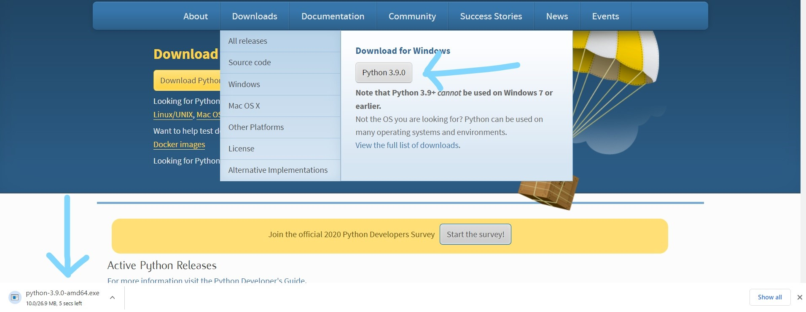
STEP 2
Download Python 3.9.0 and click on the exe file once downloaded then run it.

Slide 9
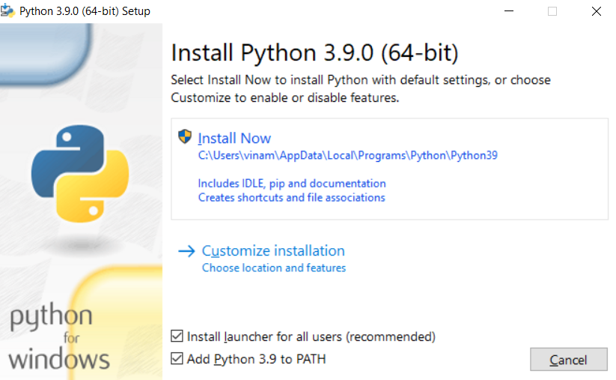
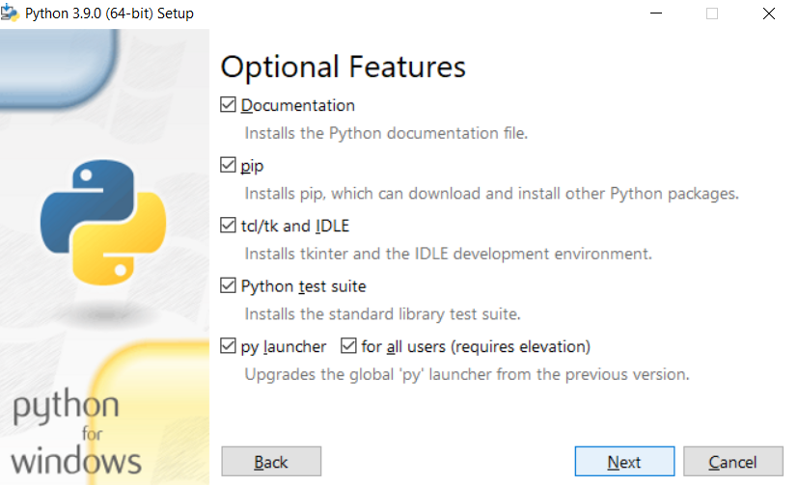
STEP 3
1)Check the lowest box which says Add Python to PATH and select customize installation.
2)Make sure all boxes are checked on the next page and continue.

Slide 10
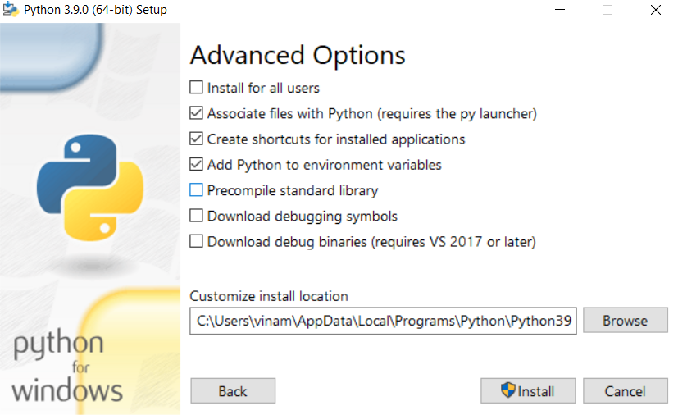
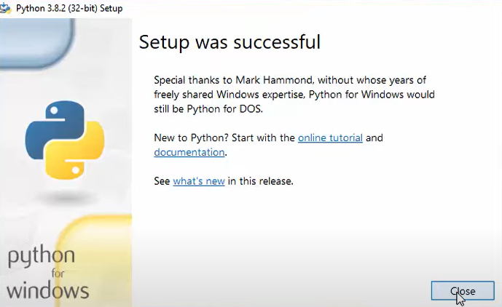
STEP 4
Check whether all the boxes shown below are checked and hit install. You can change installation directory below if you want.

Slide 11
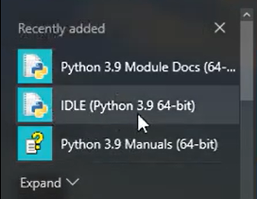
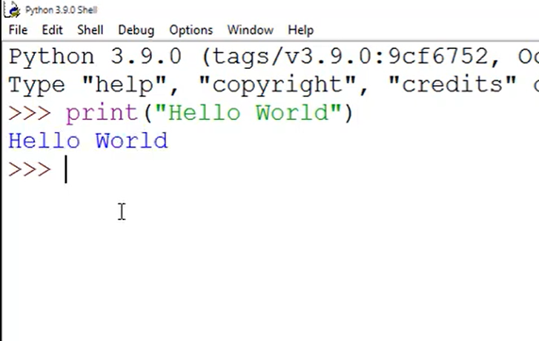
STEP 5
Search IDLE on your start menu and open it up.
You will be able to see whether the correct version was installed which is 3.9

Slide 12
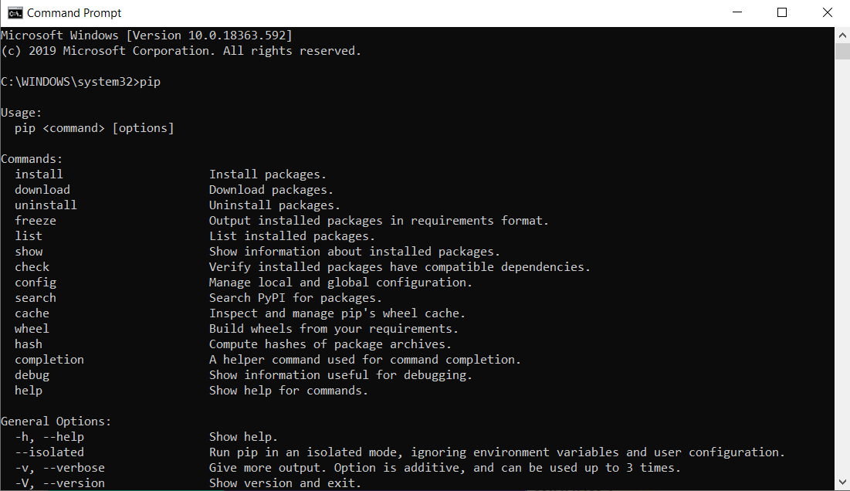
STEP 6
Open up your command prompt by typing cmd in start menu.Type pip and hit enter to see if you get an extensive menu of pip commands as shown below.

Slide 13

Next Segment:
Basic python code tutorial

